Slide 1

Multi-Model ML Toolkit
Presented By- Aditya Joshi, Shivani Singh, Karan Gupta

Slide 2
Requirements
Web client to upload data
Backend in C++
Ability to extend to different file types (multi-modal)

Slide 3
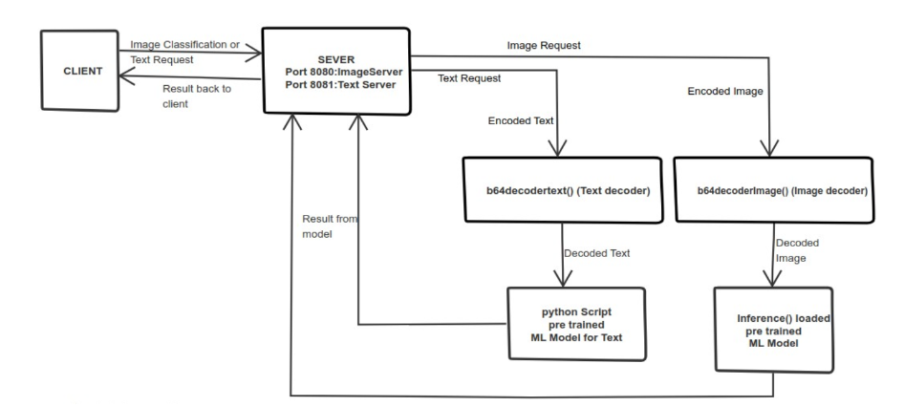
Design & Architecture

Slide 4
External Libraries / Dependencies
C++
ONNXRuntime
OpenCV
Boost (beast/asio/algorithm)
Python
Tensorflow
Numpy
Tf2Onnx
Openai
OpenCV

Slide 5








Open Neural Network Exchange (ONNX)
Sponsored by
Frameworks supported
ONNX (Open Neural Network Exchange) is an open-source format for representing machine learning models. ONNXRuntime is a cross-platform, high-performance inference engine for ONNX models. Together, they enable interoperability and efficient deployment of AI models across various frameworks and hardware platforms.

Slide 6
Language wise work distribution
C++
Setting up ports to listen
Creation of threads for separation
Decoding HTTP request
Extracting data and parsing
Invoking Python Script
Maintaining IPC
Returning HTTP request with code
Python
Data preparation
Model Training
Exporting model to onnx format
Fetching openai embeddings
Classification of text

